Slide 1
Matrix and Statistics for Machine Learning FAI- Unit-II

Slide 2
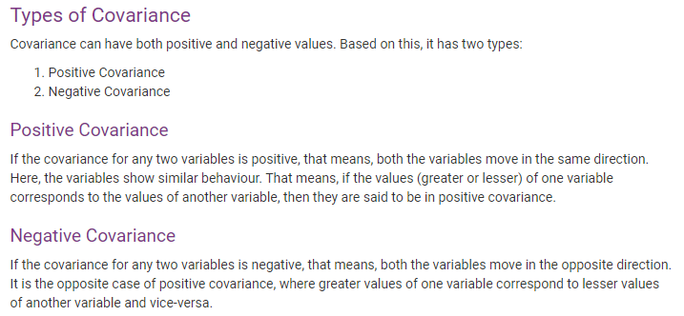
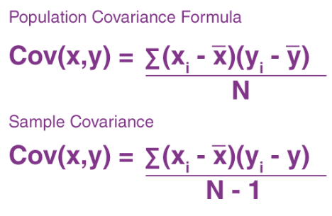
Covariance
Covariance is a measure of the relationship between two random variables and to what extent, they change together. Or we can say, in other words, it defines the changes between the two variables, such that change in one variable is equal to change in another variable.
Where,
xi = data value of x
yi = data value of y
x̄ = mean of x
ȳ = mean of y
N = number of data values.

Slide 3
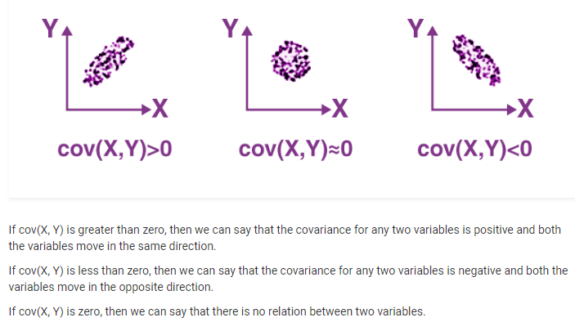

Slide 4
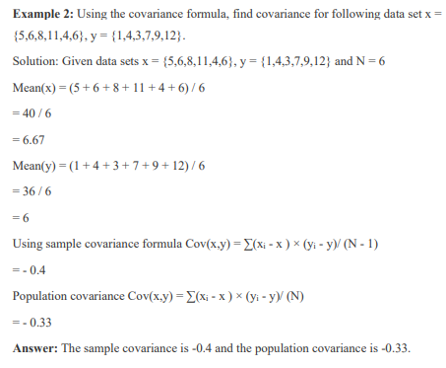
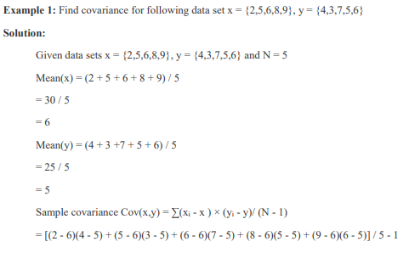
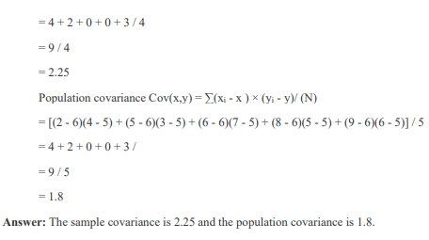

Slide 5
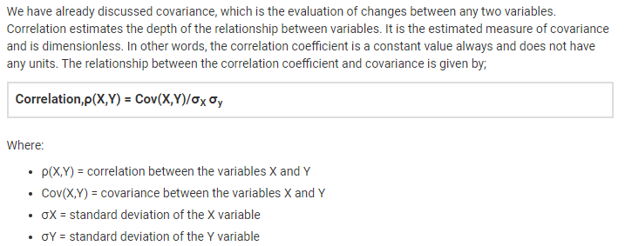
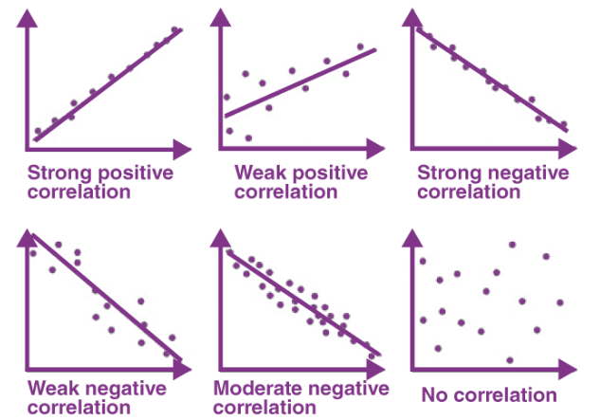
Correlation

Slide 6
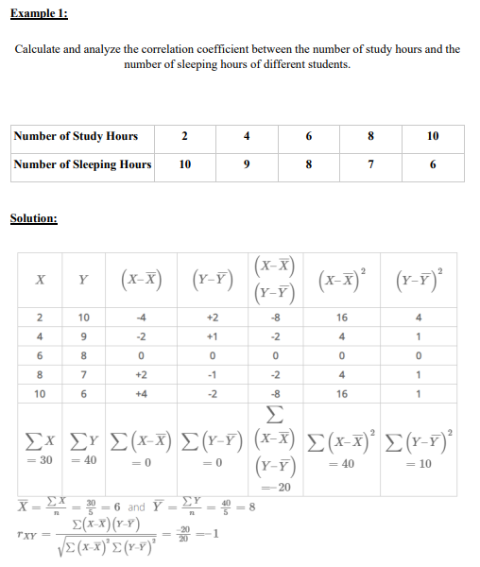
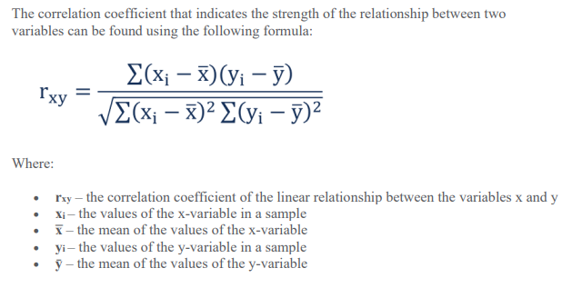

Slide 7
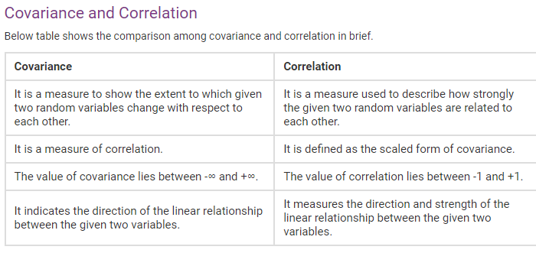

Slide 8
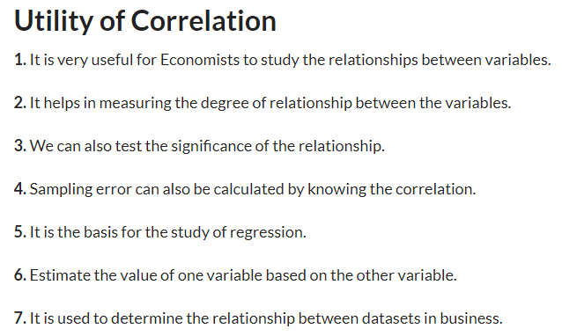

Slide 9
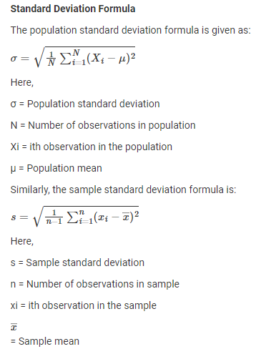
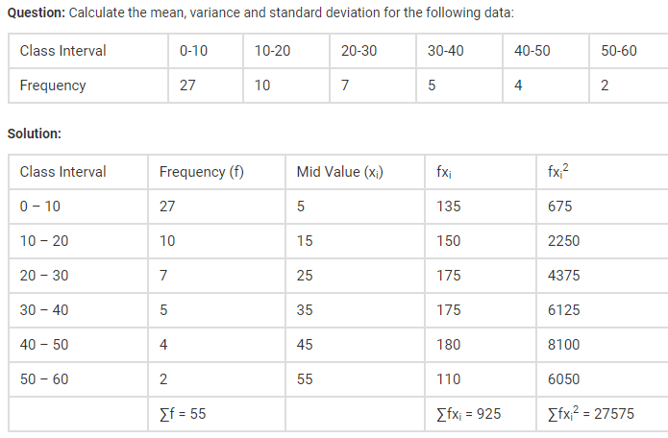
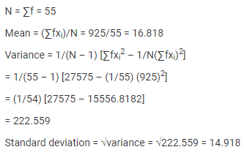
Standard deviation
Standard Deviation is a measure which shows how much variation (such as spread, dispersion, spread,) from the mean exists. The standard deviation indicates a “typical” deviation from the mean. It is a popular measure of variability because it returns to the original units of measure of the data set.

Slide 10
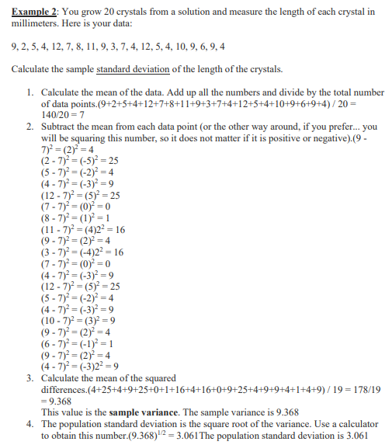
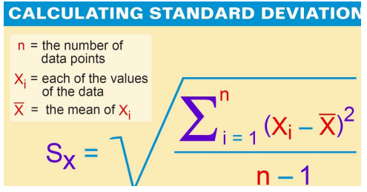

Slide 11
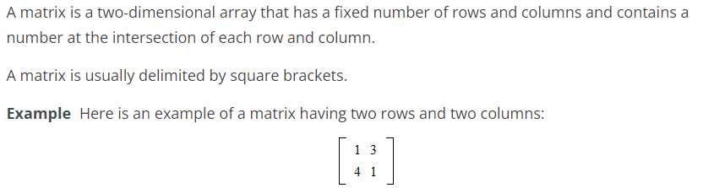
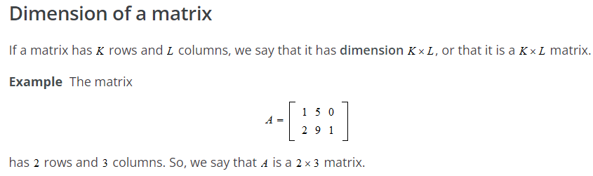
Matrix-Vectors

Slide 12
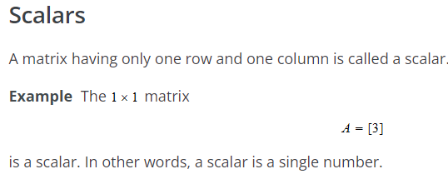
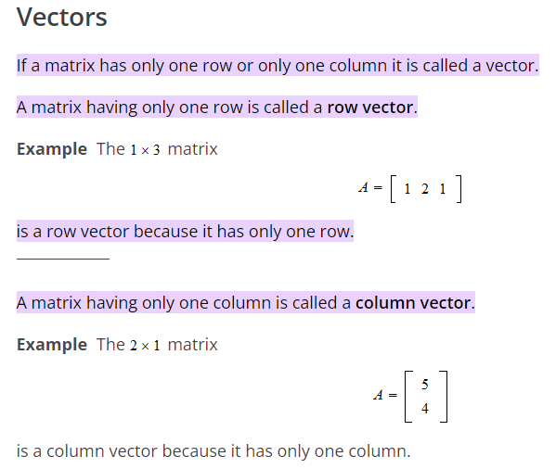
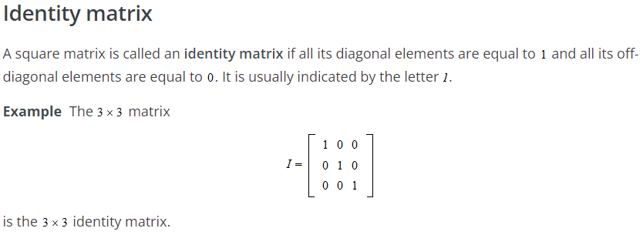

Slide 13
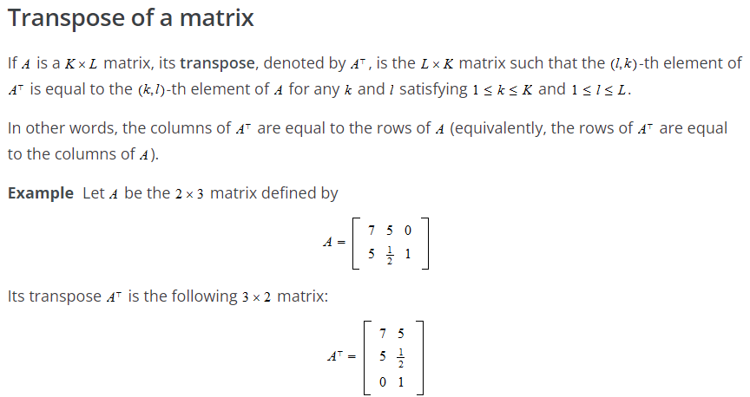
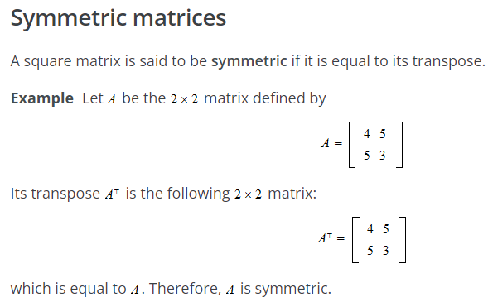

Slide 14
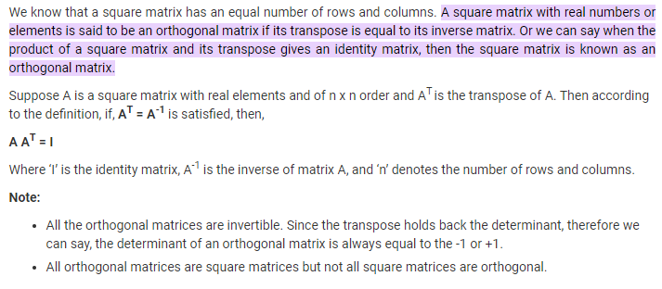
Orthogonality matrix

Slide 15
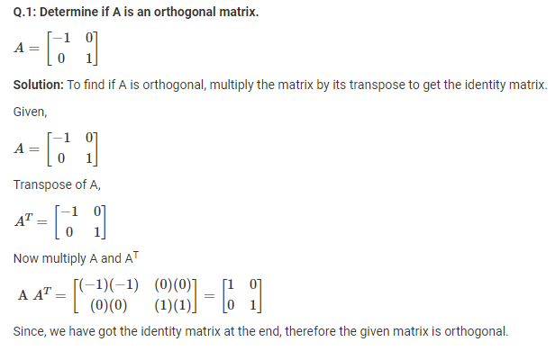

Slide 16
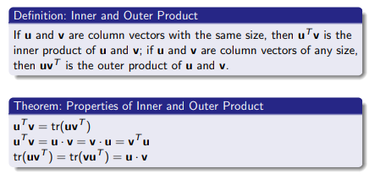
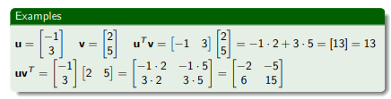
Inner and outer product of Matrix

Slide 17
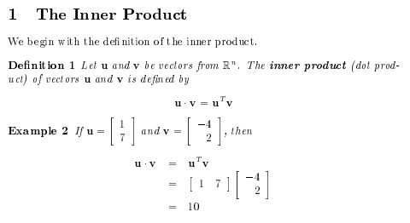
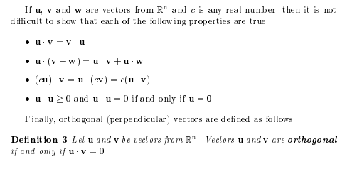
Projection matrix
In linear algebra, a projection matrix is a matrix associated to a linear operator that maps vectors into their projections onto a subspace.

Slide 18
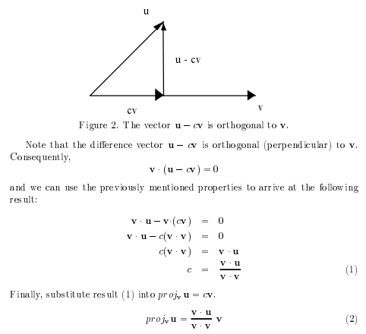
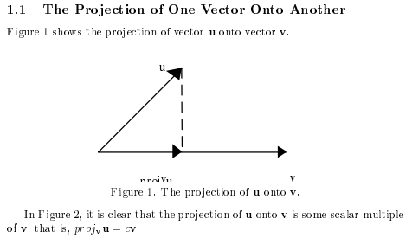
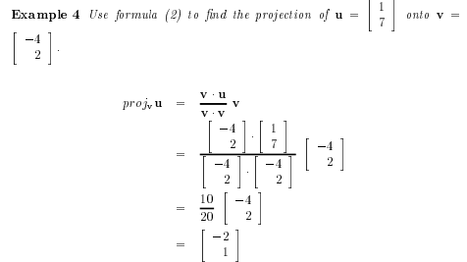

Slide 19
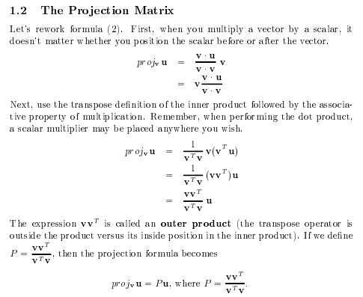
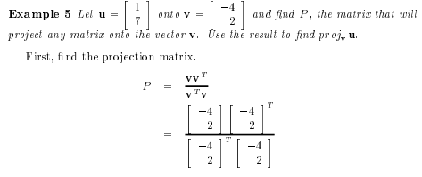
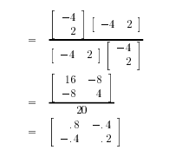

Slide 20
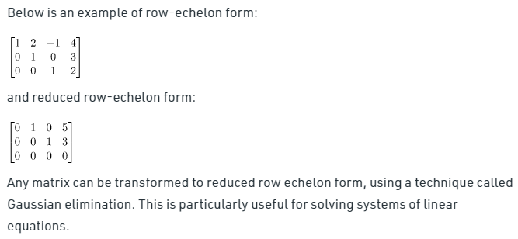
Echelon form of Matrix
A matrix is in Row Echelon form if it has the following properties:
Any row consisting entirely of zeros occurs at the bottom of the matrix.
For each row that does not contain entirely zeros, the first non-zero entry is 1 (called a leading 1).
For two successive (non-zero) rows, the leading 1 in the higher row is further left than the leading one in the lower row.
For reduced row echelon form, the leading 1 of every row contains 0 below and above its in that column.

Slide 21
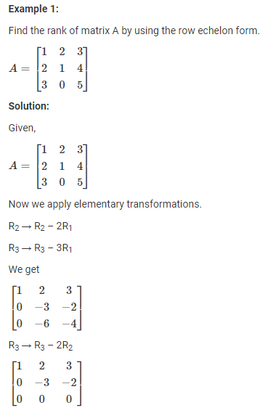
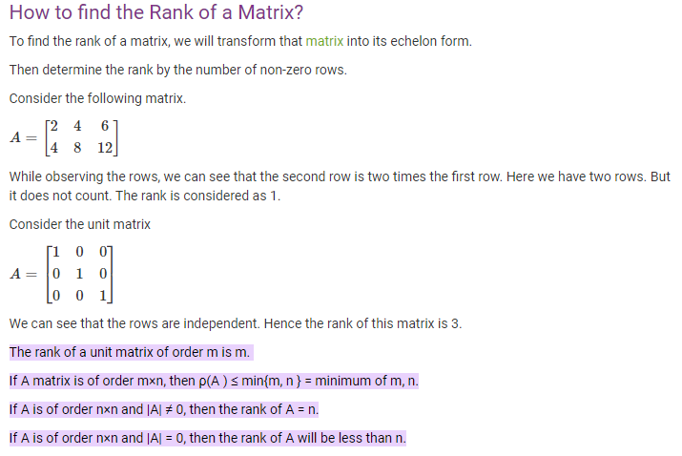

Rank of matrix
The maximum number of its linearly independent columns (or rows ) of a matrix is called the rank of a matrix. The rank of a matrix cannot exceed the number of its rows or columns.

Slide 22
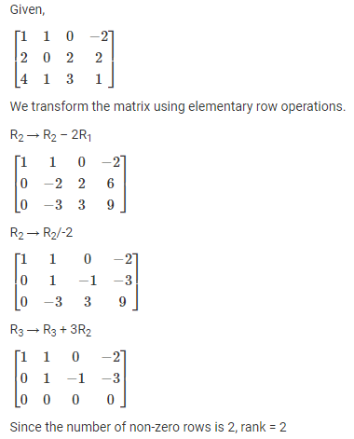
Example 2

Slide 23
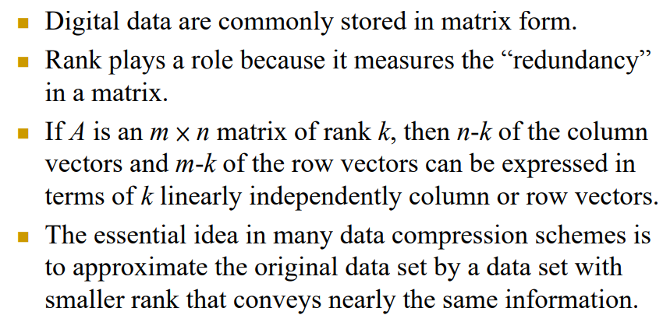
Applications of Matrix Rank

Slide 24
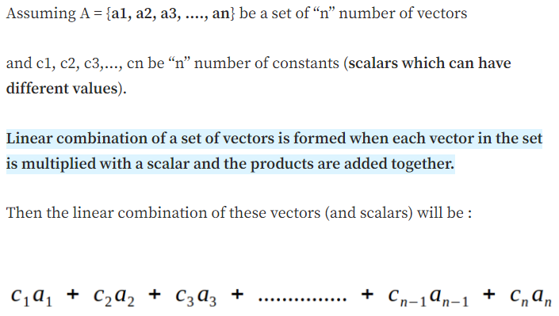
Linear Independence, Rank of Matrix, and Span

Slide 25
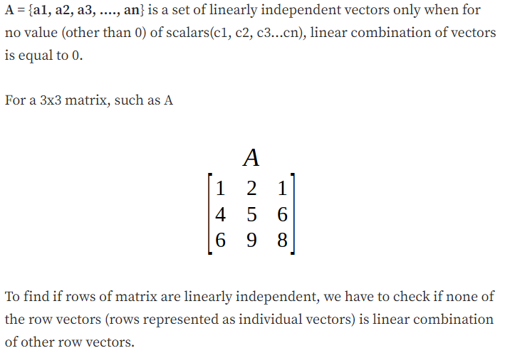
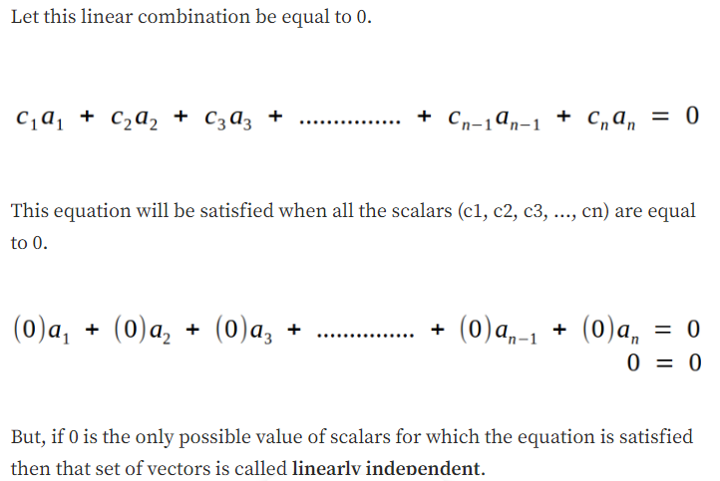

Slide 26
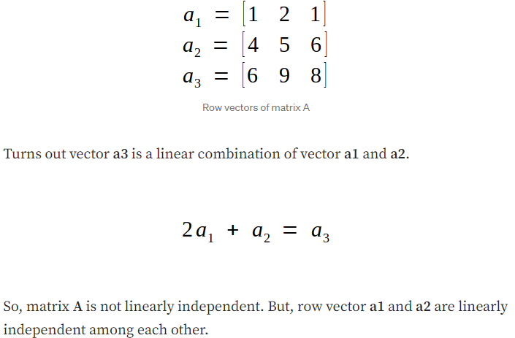
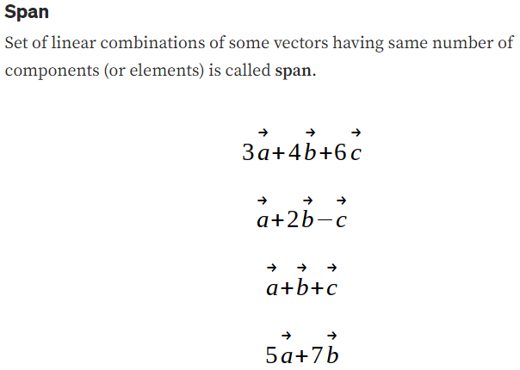

Slide 27
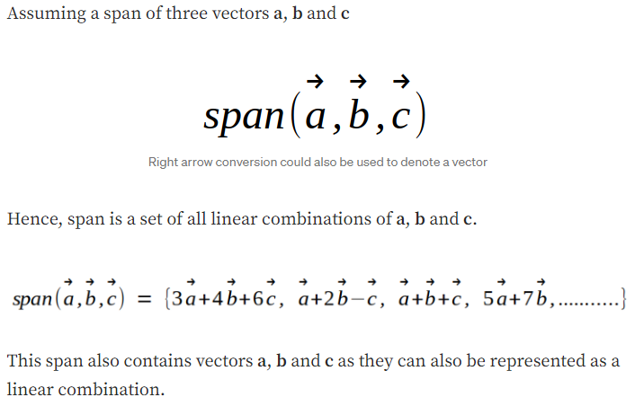
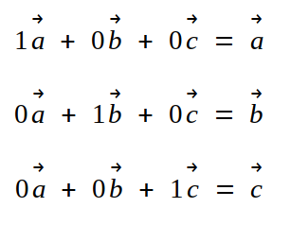

Slide 28
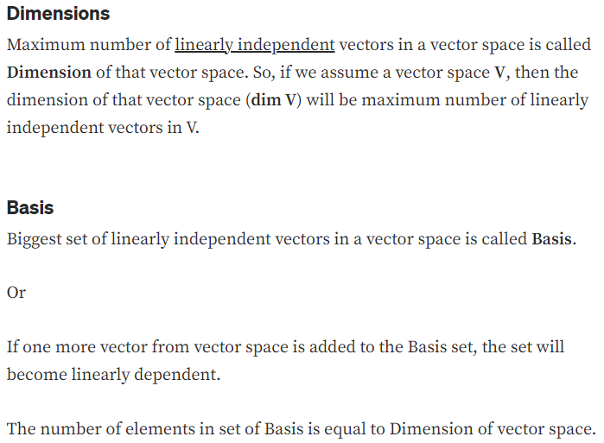

Slide 29
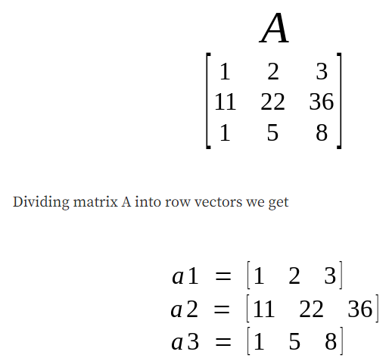


Row Space, Column Space, and Null Space
The span of row vectors of any matrix, represented as a vector space is called row space of that matrix.
or
If we represent individual columns of a row as a vector, then the vector space formed by set of linear combination of all those vectors will be called row space of that matrix.
Assuming a 3x3 matrix A
Column Space
Column space is a vector space formed by set of linear combination of all column vectors of the matrix.
Column vectors of matrix A

Slide 30




Null Space
We are familiar with matrix representation of system of linear equations.
Nullity
Dimension of null space is called nullity.
Nullity of the system above is 1.
Here A is coefficient matrix, X is variable matrix and 0 represents a vector of zeros
We can also find it’s solution (values of variables for which the equation above is satisfied) using Gaussian Elimination algorithm.
If we take a set of all possible solution vectors (all possible values of “x”), then the vector space formed out of that set will be called null space.

Slide 31


Column space, Row space, Null space

Slide 32


Example 1

Slide 33


Slide 34


Slide 35



Slide 36

Example 2

Slide 37

Eigen values and Eigenvectors
Definition
Let A be an n × n matrix. A scalar λ is called an eigenvalue of A if there exists a nonzero vector x in R^{n} such that
Ax = λx.
The vector x is called an eigenvector corresponding to λ.
Let A be an n × n matrix with eigenvalue λ and corresponding eigenvector x. Thus Ax = λx. This equation may be written
Ax – λx = 0
given
(A – λI_{n})x = 0
Solving the equation |A – λI_{n}| = 0 for λ leads to all the eigenvalues of A.
On expending the determinant |A – λI_{n}|, we get a polynomial in λ. This polynomial is called the characteristic polynomial of A.
The equation |A – λI_{n}| = 0 is called the characteristic equation of A.

Slide 38


Example 1

Slide 39


Example 2

Slide 40


Slide 41


Example 2

Slide 42




Slide 43


Slide 44



Slide 45



Slide 46




Slide 47



